Slide 1
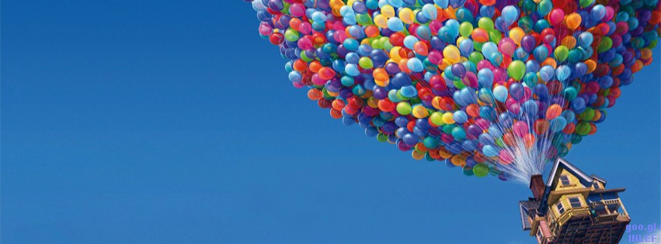
PERFECT TENSES

Slide 2
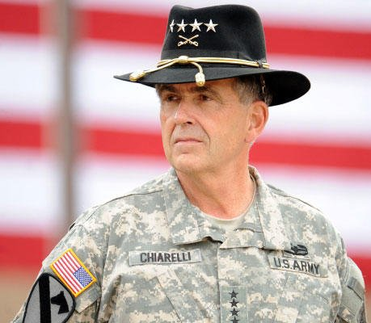
I think I had a very interesting life. I’m 73 now and I don’t work anymore. I was in the army for 51 years. I retired when I was 69.I have been to so many countries that I can’t remember all of them. I have been to Australia six or seven times and to South Africa three times. I've also been to Russia, but I didn’t like it at all : much too cold for me.
I’ve never been on television, but I’ve been on the radio once. It was a programme about life in the military about twenty years ago. I met the Prime Minister on the same day. Actually I’ve met a lot of famous people: members of the royal family, famous politicians and famous cinema and television personalities. I've never met the American President though which is a pity.
Because I travelled a lot, I’ve seen a lot of wonderful things and have also eaten and drunk strange foods and drinks. I ate cat and rat in India and drank something called Mirto on a little island in Italy many years ago.
PRESENT PERFECT TENSE

Slide 3
actions that started in the past and continue to the present
I have been a teacher for 14 years.
Technology has done more harm than good.

Slide 4
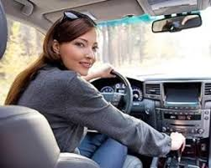
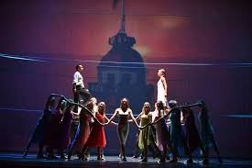
single or repeated actions in the past, when we don’t know the date of the action or it isn’t important
I’ve driven an automatic car before.
I’ve been to the theatre many times.

Slide 5
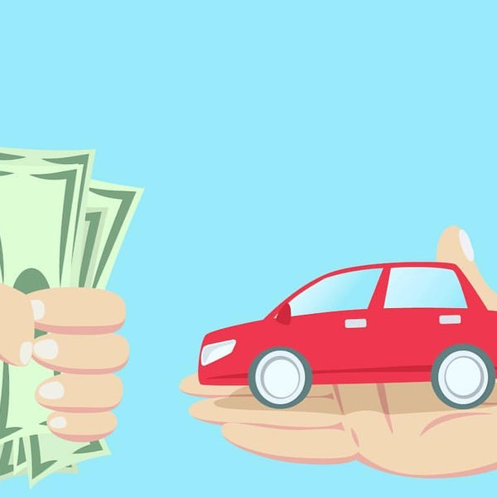
one or more completed actions in a time period that is still continuing
He’s sold fifteen cars this month.

Slide 6
FORM
HAVE
VERB(PAST PARTICIPLE)
S
+
+
HAS
I have known him for since 2009.
It has rained all day.
She has broken her leg.
They have been married for twenty years.

Slide 7
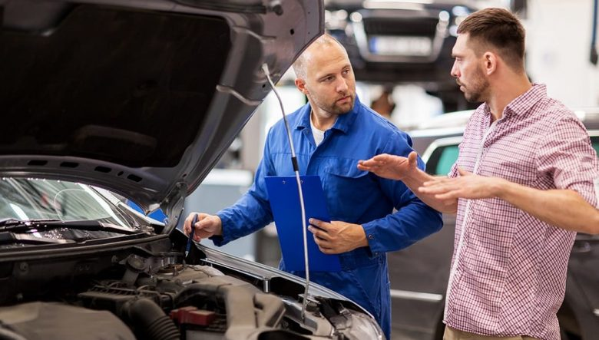
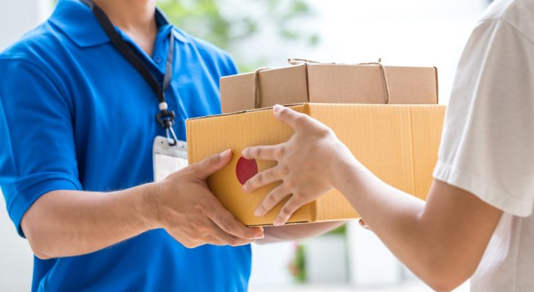
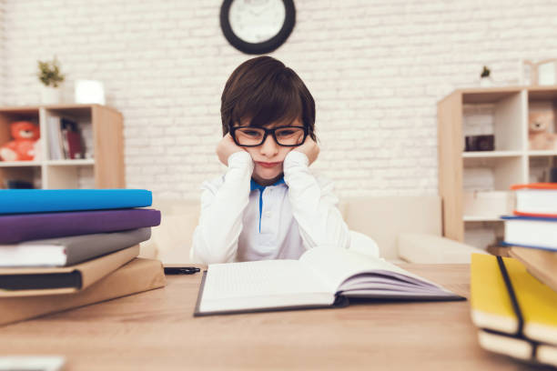
He has just repaired the car.
just
They have already caught the thief.
already
yet
She hasn’t delivered the parcel yet.
Has he done his homework yet?

Slide 8
since
for
last Tuesday
twenty years
2 o’clock
a year
1990
I was a child
a long time
yesterday
a month
this morning

Slide 9
1.Jenna …….. never….. ……… (attend) an art class,but she…………………...(paint) some amazing pictures.
2.James……………………… (lose) his keys, so he can’t get into the building.
3. My cousins ………… never ……….. (be) to the new theme park, but they really want to go.
4. ………….. Rita ……………………(get) her exam results yet?
5. My friend Daisy ……………………….. (not try) tortillas before.
6.I ………………… (miss) three days of school so far this year.I was ill with the flu.
7. Mr. Kent isn’t here at the moment.He …………………….. (go) to the science lab.
8.My first day in Buenos Aires …………………….(be) great so far.
9.Brian ……………………..(play) two different video games since he got home.
10.My best friend ……………………………………..(not write) for so long.

